Slide 1

DevOps & Cloud Infrastructure SEIS 665 Week 8
Jason Baker
Adjunct Instructor
Graduate Programs in Software
University of St. Thomas
St. Paul, MN

Slide 2
Agenda
Application architectures
N-tier
Service oriented architecture (SOA)
Microservices architecture
APIs
REST/ JSON/ YAML

Slide 3
Application Architecture
Application architecture determines how we connect and configure infrastructure components:
Communication channels
Resiliency
Scalability
Security

Slide 4
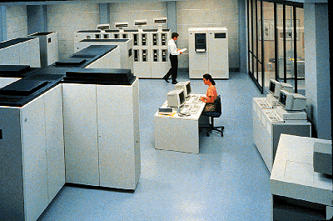
In the beginning…
1-tier architecture
Single centralized computing on mainframes
Applications accessed via dumb terminals
Advantages:
Only one system to maintain
Infrastructure never changes
Disadvantages:
Can’t scale beyond one system
Software tightly coupled to infrastructure

Slide 5
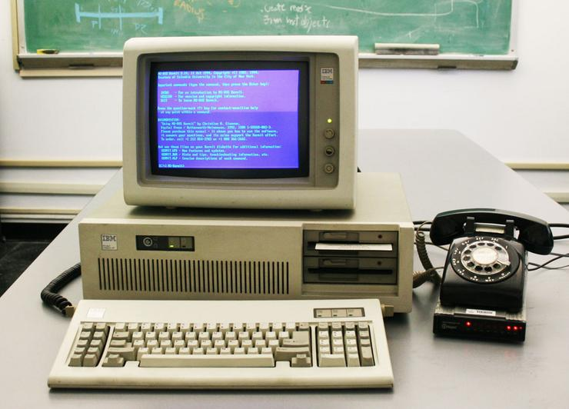
The PC Era
2-tier architecture (Client/Server)
PC’s powerful enough to run a software client application
Fat clients: perform some business logic on the client
Thin clients: mostly just provide user interface
Advantages:
User friendly
PC could access several different servers
Network = longer distance
Disadvantages:
Greater communication and software complexity

Slide 6
Client-Server Architecture
Servers provide services that are consumed by clients.
Servers don’t need to know anything about clients, but clients must know about servers.
Clients and servers are logical processes and could be running on the same physical hardware.

Slide 7
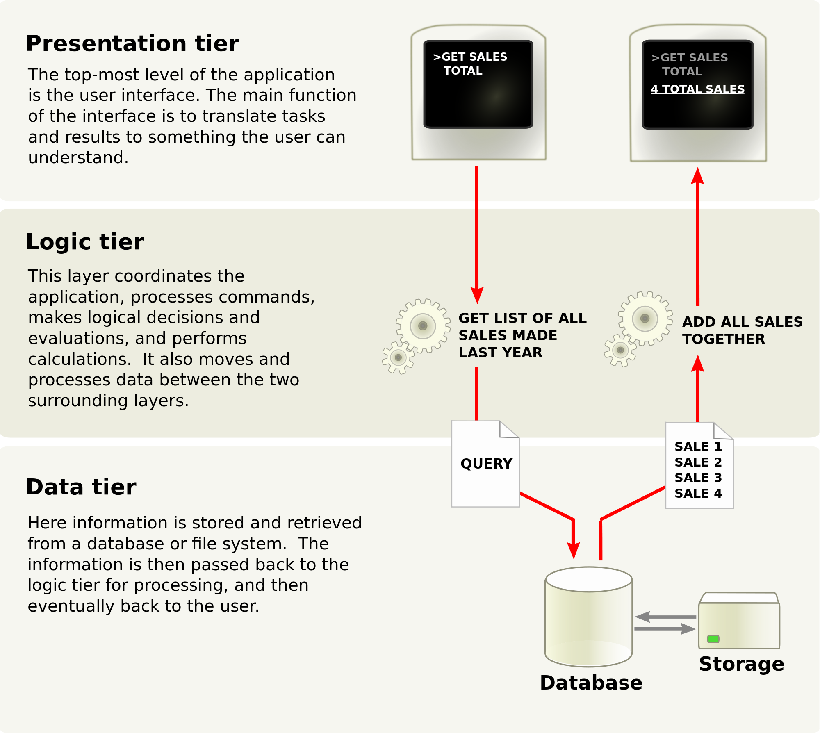
Client-Server Application Layers

Slide 8
Client-Server Application Layers
Presentation layer does not have direct access to the data layer – database structure is hidden.
Each tier can scale horizontally, independently of other tiers.
We can use load balancing at each layer to distribute requests.
We can also potentially cache requests between layers to improve performance.

Slide 9
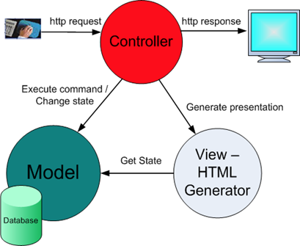
Client-Server <-> MVC
Application Layers map to MVC software model.
Presentation = View
Logic = Controller
Data = Model

Slide 10
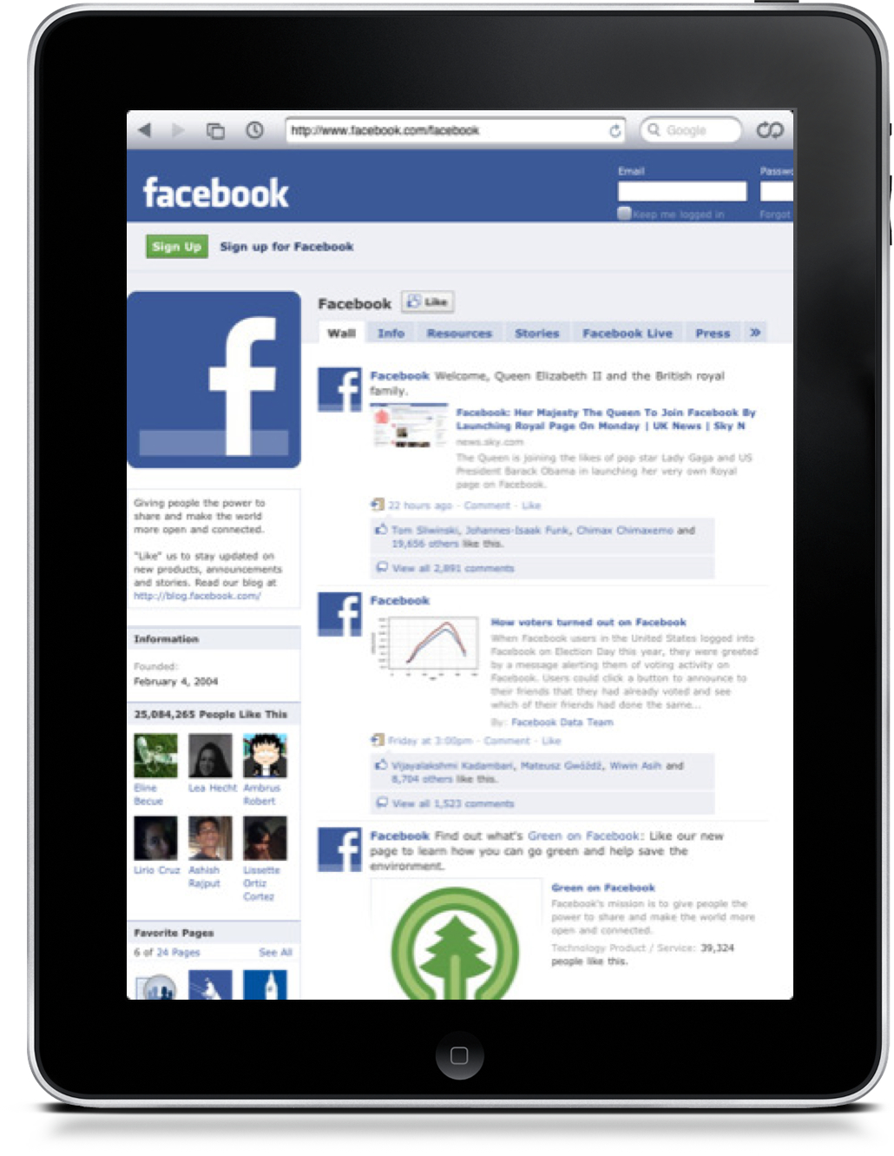
The Web Era
3-tier (or 4-tier) architecture (Client/Server)
Presentation, logic, and data layers deployed on separate systems
Standardize on a presentation layer (browser)
Advantages:
Flexible presentation layer
Global scale applications via Internet
Access from nearly any device
Disadvantages:
More complex to scale
Greater support requirement (always on 24x7)

Slide 11
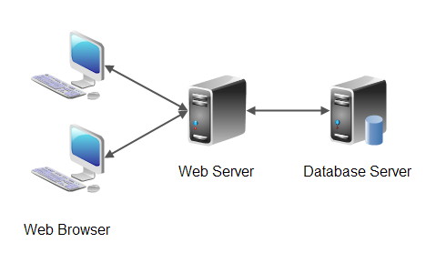
3-tier Web Application

Slide 12
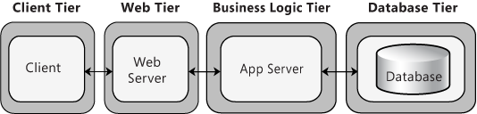
4-tier Web Application

Slide 13
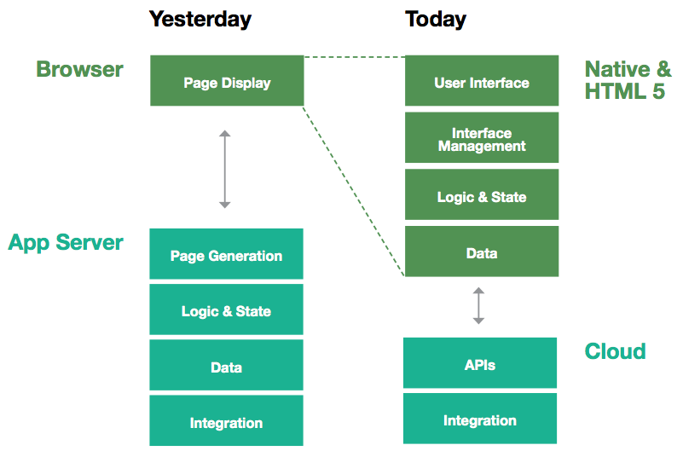
Modern Web Application Architecture

Slide 14
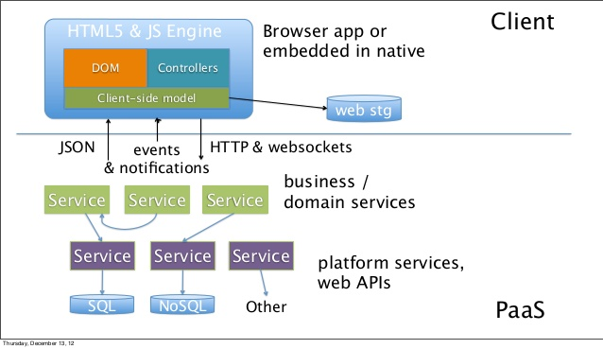
Modern Web Application Architecture

Slide 15
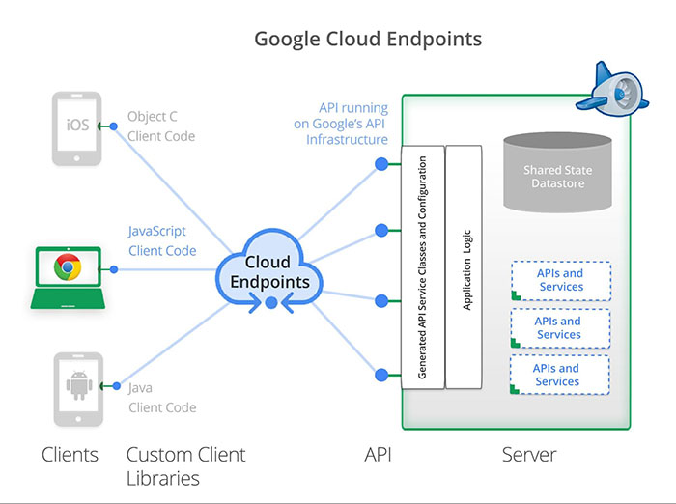
Cloud Application Architecture

Slide 16
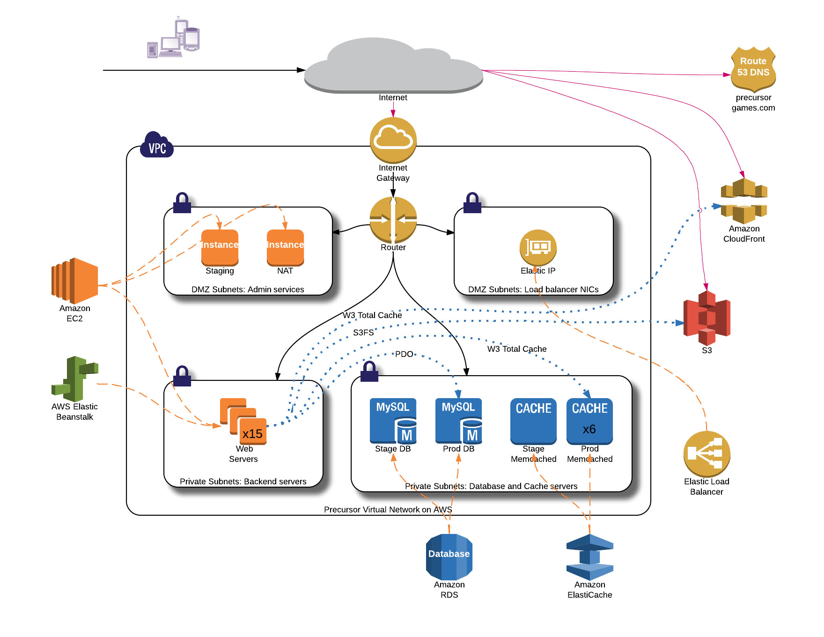

Slide 17
Scaling Cloud Applications
We can scale each layer of the cloud application stack independently.
Presentation uses frontend webservers, reverse proxies, and CDN.
Logic uses distributed application servers and message bus.
Backend uses database replicas, shards, and caches.
Distribution is handled by load balancers.
Round Robin, Weighted, Least Loaded, etc.
Discussed in Week 3

Slide 18
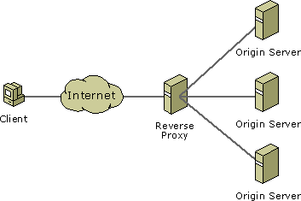
Reverse-Proxy servers
Reverse-proxy servers transparently query other web servers.
May be combined with a caching solution (like Varnish) to accelerate handling of static content.
Or, combined with a web application firewall (WAF).

Slide 19
Application State
Application state can have a big impact on load balancing configuration.
Applications that require state use sticky sessions. ☹
Applications that don’t require state are considered state-less. ☺
In a web application, state is usually stored in a client browser using a cookie containing a session ID associated with the client account.
Sticky sessions: load balancer will try to direct clients to the same server they originally connected to because the local server stores state.
Shared state: load balancer can direct clients to any server because all servers access centrally stored state (ElastiCache/Redis).

Slide 20
Design Patterns for Scaling
Premature optimization: spending too much time preventing scaling problems that may or may not occur.
Bottlenecks: always identify and optimize constraints within a system first.
Optimizing before the bottleneck will lead to large backlogs.
Optimizing after the bottleneck does little to improve overall throughput.
3 basic options for scaling:
Horizontal: distribute requests across set of replicated systems.
Functional: split the system into individual functions or services.
Lookup: split the system data into individual chunks (example: hashing).

Slide 21
Design Patterns for Scaling
Caching: small data store using fast/expensive media intended to improve slower/cheaper media.
Cost effective only if benefit from the cache is greater than cost of the cache.
20 instances required without cache vs. 15 with cache = delta of 5 instances.
Pre-warming cache
New cache starts empty which leads to poor performance.
Warm up cache by pre-loading data.
Persist cache to disk via snapshot (Redis)

Slide 22
Service Oriented Architecture (SOA)
Large organizations run hundreds and thousands of applications.
Some application functionality is duplicated within organizations.
SOA seeks to centralize and encapsulate commonly used functionality in shared services.
DRY Principle = Don’t Repeat Yourself
Easier to design and maintain one service versus dozens of duplicate services.
IT consultants and leaders have been pushing SOA for the last decade.

Slide 23
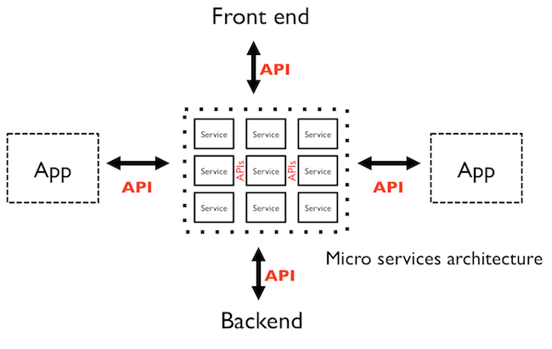
Microservices Architecture
Modern approach to SOA is to create small services that are tied together using APIs to build larger applications.

Slide 24
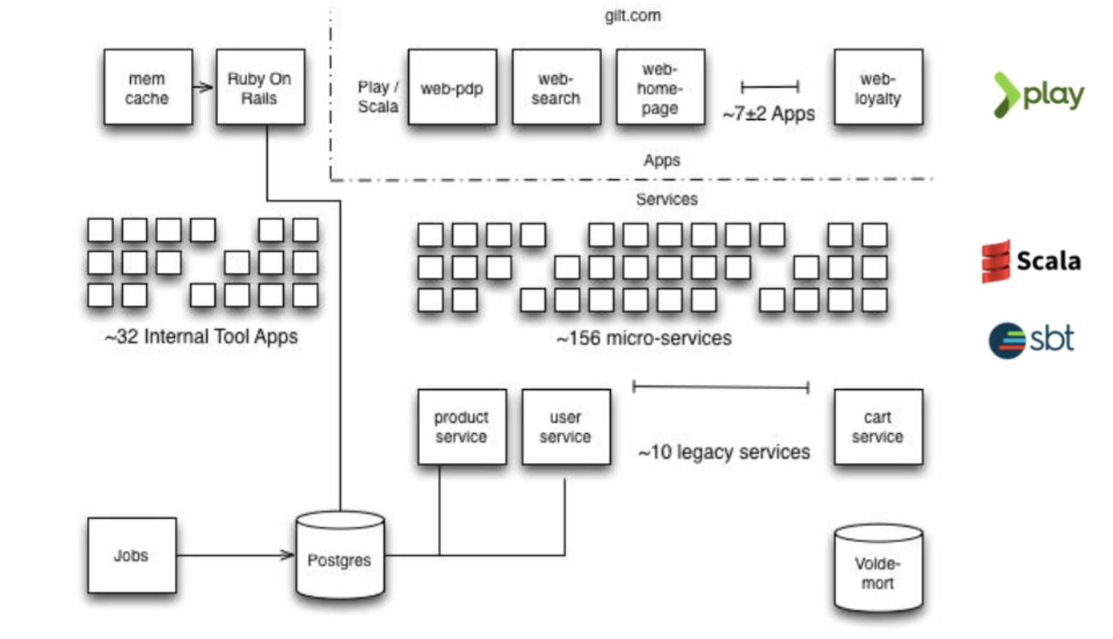
Gilt.com Microservices Example

Slide 25
Microservices Pros & Cons
Benefits of microservices:
Small teams can work on each service.
“Right tool for the right job.”
Services can be scaled and deployed independently.
Disadvantages:
Distributed systems are more challenging to design and maintain.
Services like load balancing and service discovery are essential.

Slide 26
Application Programming Interface (API)
An API provides a programmatic method to interact with a software application.
Allows software to communicate with other software. (client-server)
Wide variety of different API formats in the marketplace.
Most APIs provide some form of CRUD functionality.
Create, Read, Update, Delete
APIs often secured using an access token.

Slide 27
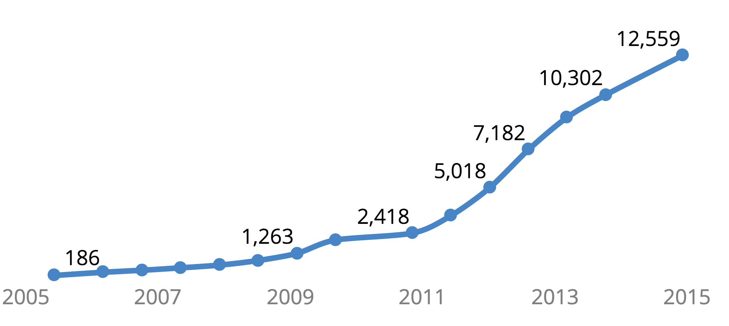
Growth of Public APIs
Source: Programmable Web

Slide 28
Why APIs Matter
Only software developers deal with APIs… (not really)
API usage impacts network architecture and performance, service scaling, database configuration, etc.
APIs provide an abstraction layer to decouple services from one another.
Don’t need to understand how an application works, just how to talk to it.
Services may be provided by anyone, anywhere.
APIs form the service scaffolding upon which we build applications.
Quickly build applications leveraging services built by others.

Slide 29
Why (Web) APIs Matter
Web API: an API that uses HTTP for transport.
Most web-based applications use some form of web API.
XML-RPC, SOAP, REST, etc
AWS REST interface
Other APIs like ODBC are used to talk to databases.

Slide 30
Web API Data Formats
Web APIs generally use two different data formats to communicate:
Extensible Markup Language (XML)
JavaScript Object Notation (JSON)
Serialization: convert an application object into a text string for storage or transmission.
Application serializes data into XML/JSON and sends it to another application where the data is de-serialized.

Slide 31
XML
XML is a meta-language: it’s used to define other languages.
XML uses markup (<document></document>)
XML is extensible: you can use it to create your own tags.
XML is a data-description language that allows us to describe the data in a document.
We commonly use XML in IT to:
transmit complex data in APIs
store application and service configuration settings

Slide 32
XML Example
<breakfast_menu>
<food>
<name>Belgian Waffles</name>
<price>$6.99</price>
<description>
Our wonderful Belgian Waffles
</description>
<calories>650</calories>
</food>
</breakfast_menu>

Slide 33
JavaScript Object Notation (JSON)
Very light-weight data-interchange format.
Easy for humans to read and machines to parse.
“self-describing”
Based on subset of JavaScript programming language, but it’s completely language independent.
Built on two structures:
Name/value pairs (object/hash)
Ordered lists (array)
Values can be:
String, number, object, array, true, false, null

Slide 34
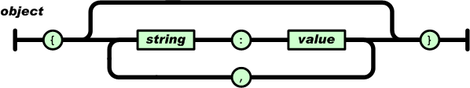
JSON Object Syntax
An Object:
Unordered set of name/value pairs
Object begins with { and ends with }
Each name followed by : (colon) and name pairs are separated by , (comma)
{ “name” : “Allie” }
{ “work” : “Target”, “home” : “Minneapolis” }

Slide 35
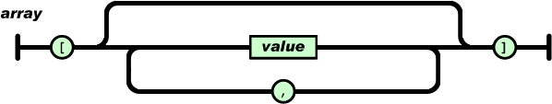
JSON Object Syntax
An Array:
Ordered collection of values
Array begins with [ and ends with ]
Values are separated by , (comma)
{ “employers” : [ “Target”, “Cargill”, “Medtronic” ] }
# nesting objects/arrays
{
“employer” : { “name” : “United Health”,
“employees” : [ “John”, “Miguel”, “Heather” ]
}
}

Slide 36
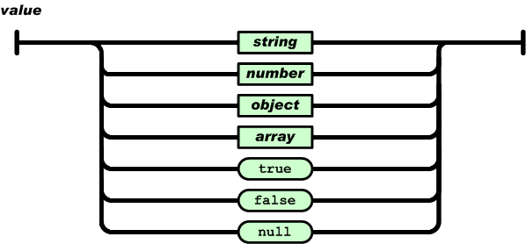
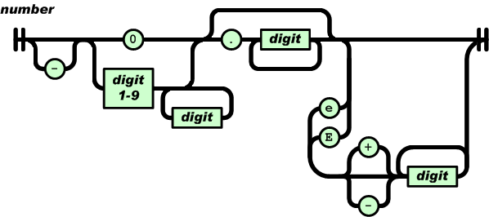
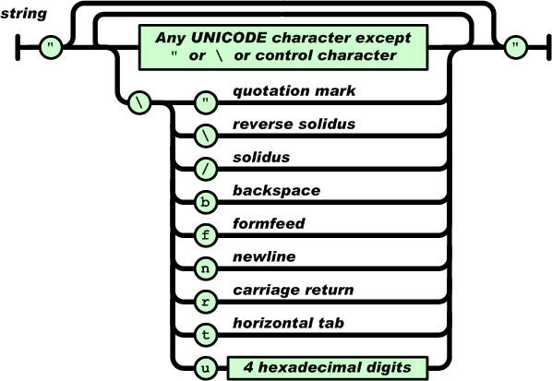
JSON Value Syntax

Slide 37
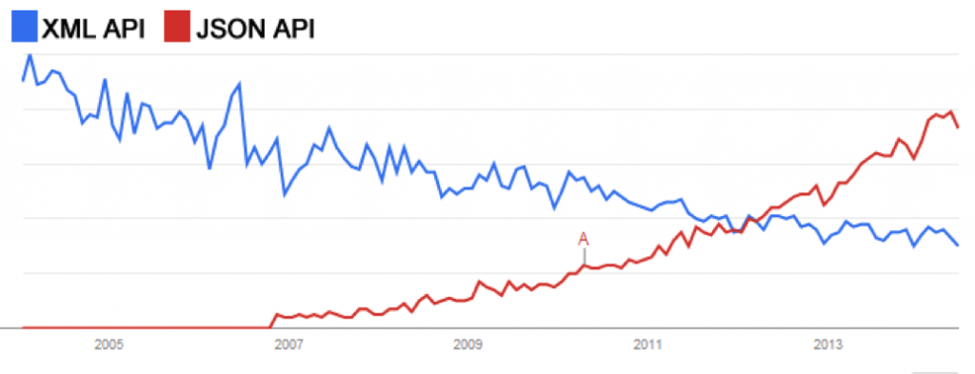
XML vs. JSON Adoption

Slide 38
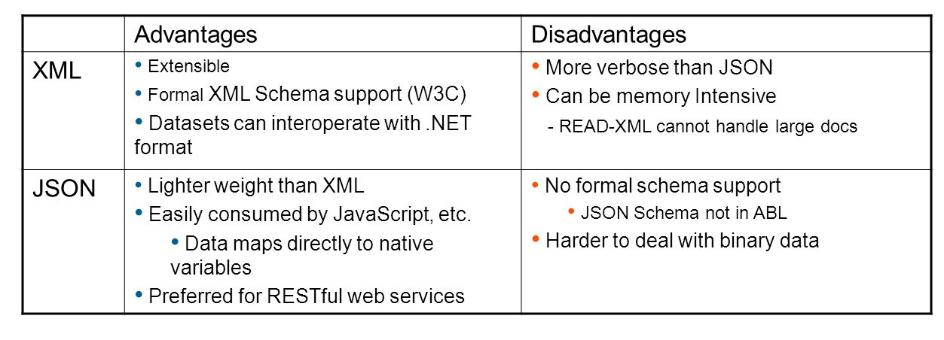
XML vs. JSON

Slide 39
XML vs. JSON
<breakfast_menu>
<food>
<name>Belgian Waffles</name>
<price>$6.99</price>
<description>
Our wonderful Belgian Waffles
</description>
<calories>650</calories>
</food>
</breakfast_menu>
{ “breakfast_menu”:
{ “food”:
[
{ “name”:”Belgian Waffles”,
“price”:”$6.99”,
“description”:”Our wonderful Belgian Waffles”,
“calories”:650
}
]
}
}

Slide 40
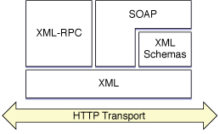
Web API Types
XML-RPC, SOAP & REST use HTTP for transport
XML-RPC & SOAP use XML for data
REST can use XML or JSON
XML-RPC: remote procedure call embedded within an XML document
SOAP: protocol based on WSDL (Web Services Description Language) that is a more advanced version of XML-RPC; (Microsoft,1998)
REST (Representational State Transfer): a data exchange architecture using HTTP and XML, JSON, or text data

Slide 41
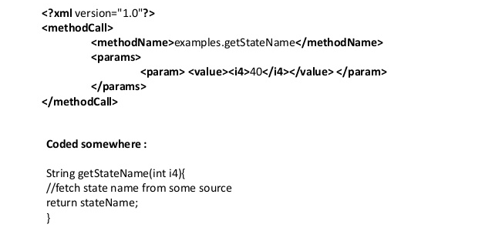
XML-RPC Example

Slide 42
SOAP Request Example
POST /calendar-request HTTP/1.1
Host: foo.bar.net
Content-Type: text/plain; charset=“utf-8”
Content-Length: 507
<SOAP-ENV:Envelope
xmlns:SOAP-ENV=“http://schemas.xmlsoap.org/soap/encoding/”
SOAP-ENV:encodingStyle=“http://schemas.xmlsoap.org/soap/encoding/”
>
<SOAP-ENV:Body>
<c:AddListing xmlns:c=“ http://foo.bar.net/soap-example/calendar “>
<c:when>
<c:Date>
<day>21</day><month>6</month><year>2012</year>
</c:Date>
</c:when>
<c:what>Meeting with management team at the office.</c:what>
</c:AddListing>
</SOAP-ENV:Body>
</SOAP-ENV:Envelope>

Slide 43
REST
It’s not a protocol, it’s an architectural approach.
Key principle: Be stateless.
Server does not store any information about the client, so any server can support any client at anytime (no sticky sessions).
Industry debate: What does it mean to be RESTful?
Design patterns describing how to exchange data using Uniform Resource Identifiers (URI) and HTTP methods.
Individual URIs are known as endpoints.
http://www.acme.com/users/1689
HTTP methods correspond to CRUD operations

Slide 44
REST HTTP Methods
CRUD / SQL Operation | REST HTTP Method
Create/ Insert | POST
Read/ Select | GET
Update/ Update | PUT
Delete/ Delete | DELETE

Slide 45
REST URI Design
URI | HTTP Method | Action
/user/ | GET | Get all users in system
/user/3 | GET | Get user with ID = 3
/user/ | POST | Add a new user
/user/3 | PUT | Update user with ID = 3
/user/3 | DELETE | Delete user with ID = 3
/user/3/accounts | GET | Get all accounts for user 3

Slide 46
REST HTTP Status
HTTP Status Code | Description
200 | Ok
201 | Resource created
204 | No content
400 | Bad Request
401 | Unauthorized
404 | No found
405 | Method not allowed
500 | Internal server error

Slide 47
REST Example
URI | HTTP Method | Description
/user/ | POST | Add a new user
Request
HTTP Method: POST
HTTP BODY:
{
“user”:”Benjamin”
}
Response
HTTP Status 201
HTTP BODY:
{
“response”:”ok”
}

Slide 48
SOAP vs. REST
SOAP | REST
Protocol | Architecture
XML-only | XML, JSON, CSV, text
SMTP, HTTP | HTTP-only
More complex | Fast, lightweight
State-ful specification | Stateless specification
Named methods | URI and HTTP methods (GET, PUT, etc.)

Slide 49
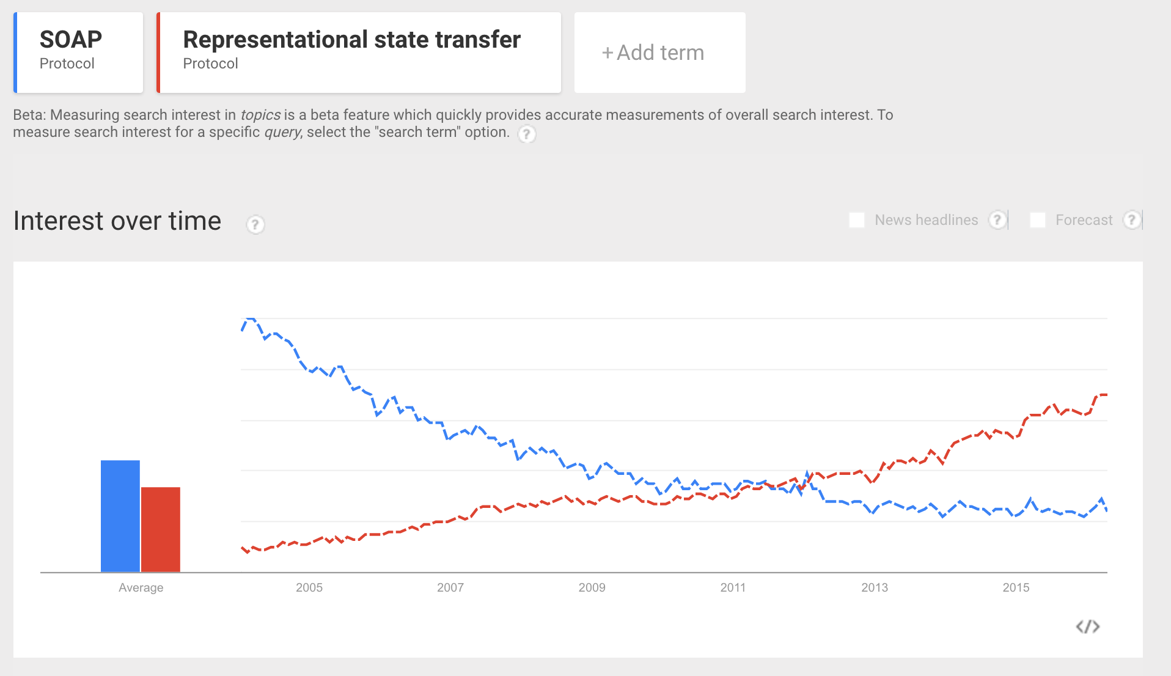
SOAP vs. REST
Source: google.com/trends

Slide 50
Data Exchange Revisited
JSON isn’t just used for data exchange, it’s also used as a storage format.
MongoDB uses a JSON-like format called BSON (Binary JSON) to store data.
JSON is primarily used by web services.
YAML (a sort of JSON superset) is more popular for data processing and configuration (Python).

Slide 51
YAML
YAML Ain’t Markup Language (YAML)
Human friendly data serialization standard for all programming languages.
Benefits:
Very simple to use.
Human readable.
Information can easily be translated to multiple programming language types.

Slide 52
YAML Rules
Basic rules:
YAML files should end with .yaml extension
YAML is case sensitive.
YAML does not allow tabs, use space instead.
Indentation (spaces) have meaning!
Data begins with 3 dashes “---” (optional)
See http://yaml.org for specific requirements.

Slide 53
YAML Data Types
Scalars:
Integer: 25
String: “25”
Float: 25.0
Boolean: Yes
Sequences (arrays):
- Cat
- Dog
- Goldfish
fish: [Cat, Dog, Goldfish]
Mappings (hashes):
animal : pets

Slide 54
YAML Example
--- !clarkevans.com/^invoice
invoice: 34843
date : 2001-01-23
bill-to: &id001
given : Chris
family : Dumars
address:
lines: |
458 Walkman Dr.
Suite #292
city : Royal Oak
state : MI
postal : 48046
ship-to: *id001
product:
- sku : BL394D
quantity : 4
description : Basketball
price : 450.00
- sku : BL4438H
quantity : 1
description : Super Hoop
price : 2392.00
tax : 251.42
total: 4443.52
comments: >
Late afternoon is best.
Backup contact is Nancy
Billsmer @ 338-4338.

Slide 55
JSON vs. YAML Example
{ “breakfast_menu”:
{ “food”:
[
{ “name”:”Belgian Waffles”,
“price”:”$6.99”,
“description”:”Our wonderful Belgian Waffles”,
“calories”:650
}
]
}
}
---
breakfast_menu:
food:
- name: Belgian Waffles
price: "$6.99"
description: Our wonderful Belgian Waffles
calories: 650

Slide 56
Homework
Assignment 7
Read Infrastructure as Code Chapters 5 & 6

